Slide 1
Forensics
Notes:
One of my favorite categories in CTFs

Slide 2
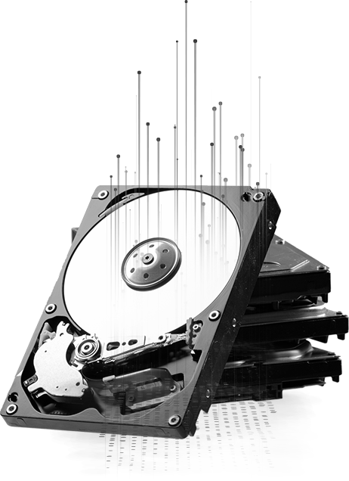
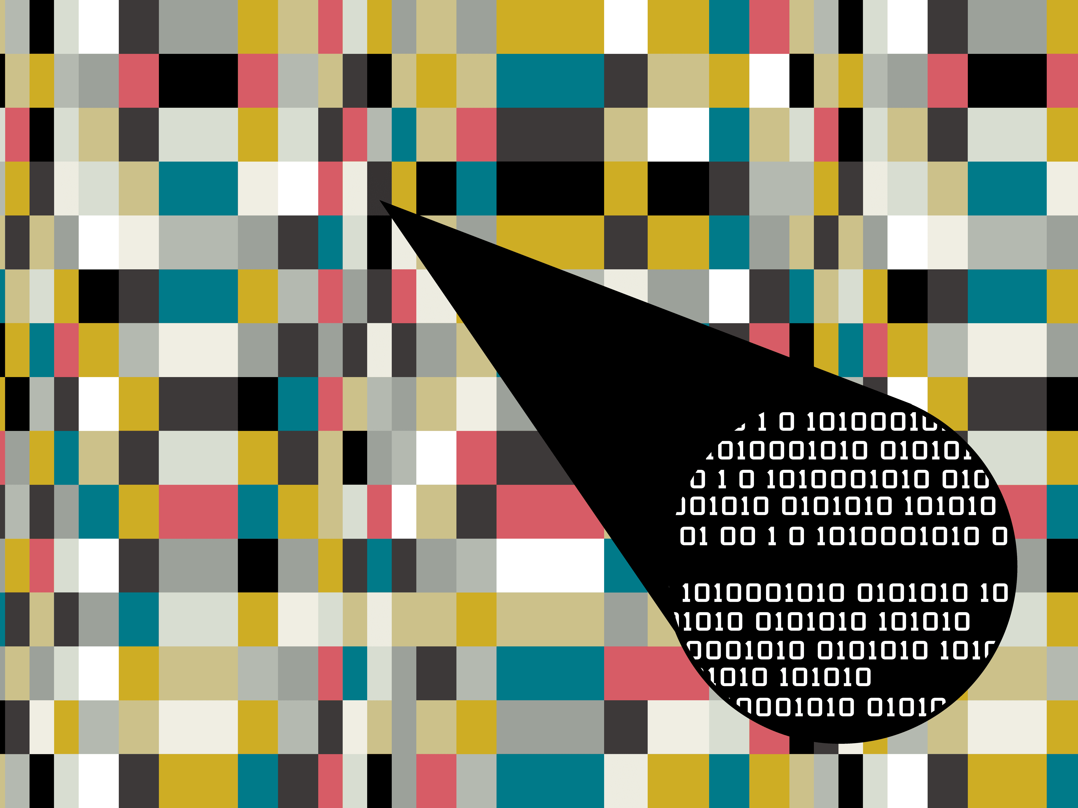

What do we mean by forensics?
Covers a wide range of techniques where you investigate and analyze evidence to recover hidden information (like the flag)
Memory & Disk Forensics
Steganography
Network Forensics

Slide 3

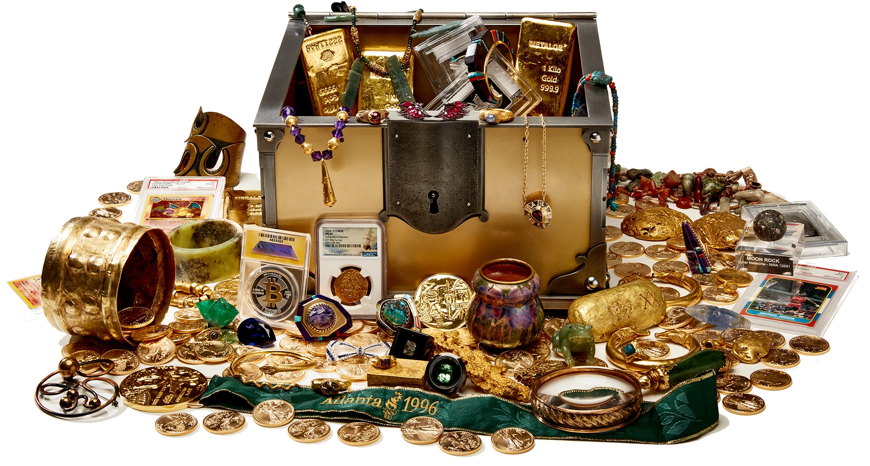
Treasure Hunting!!!
Notes:
Very applicable in our profession. The skills you learn doing forensics are also the same tools we'd use if I asked someone here's a disk image, I need you to find something.

Slide 4
What is metadata?
It's the extra information about a file or piece of data that helps you understand more about it, outside of the content itself.
It helps computers and people understand how, when, and where something was created, used, or stored.

Slide 5
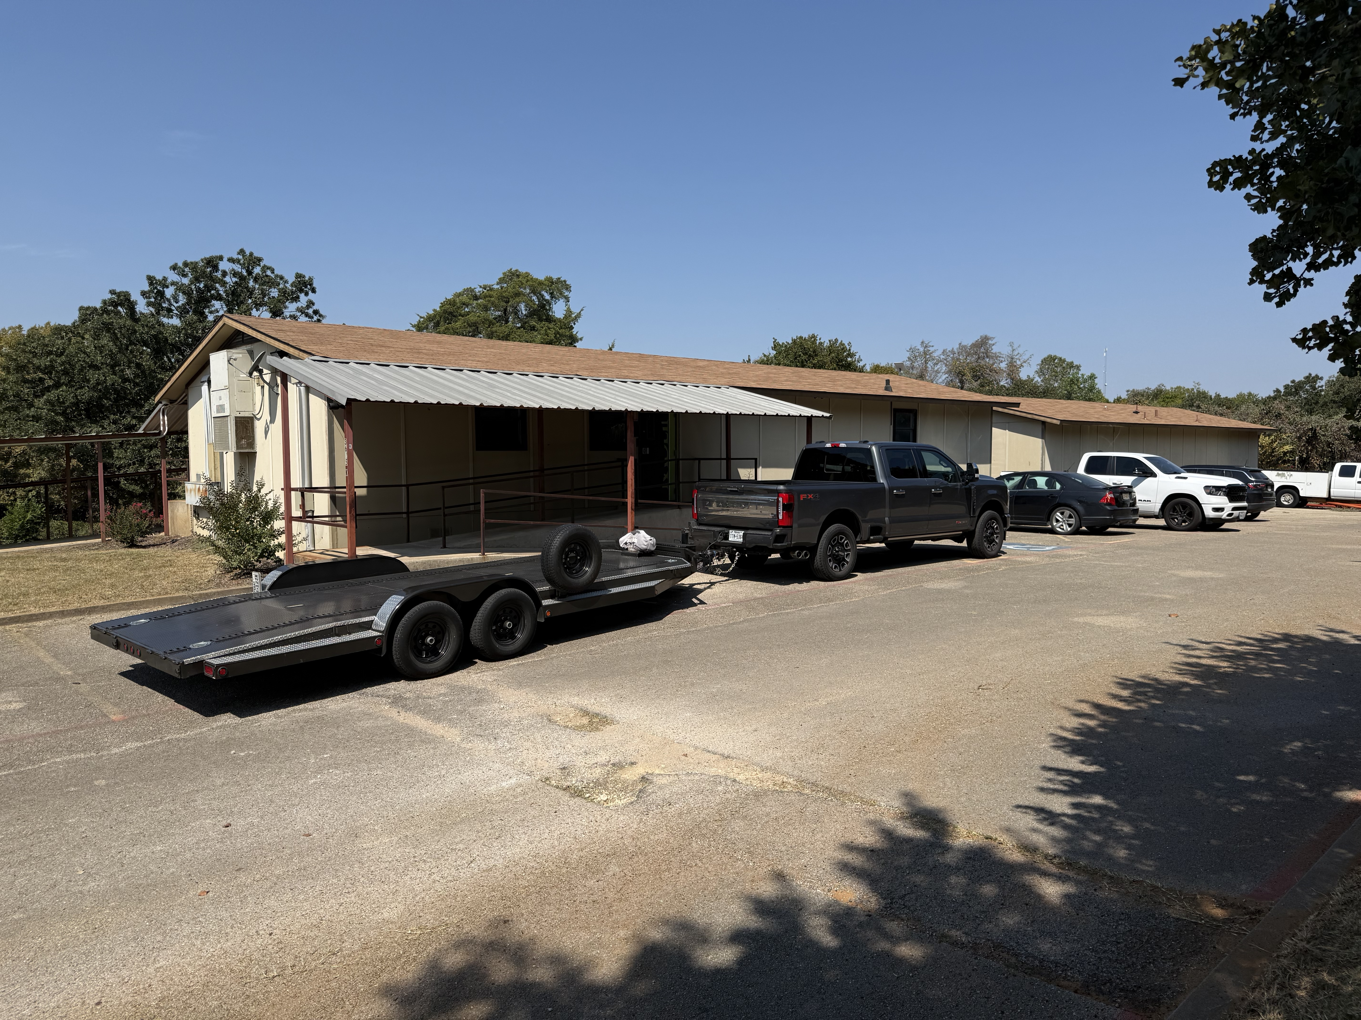

Slide 6
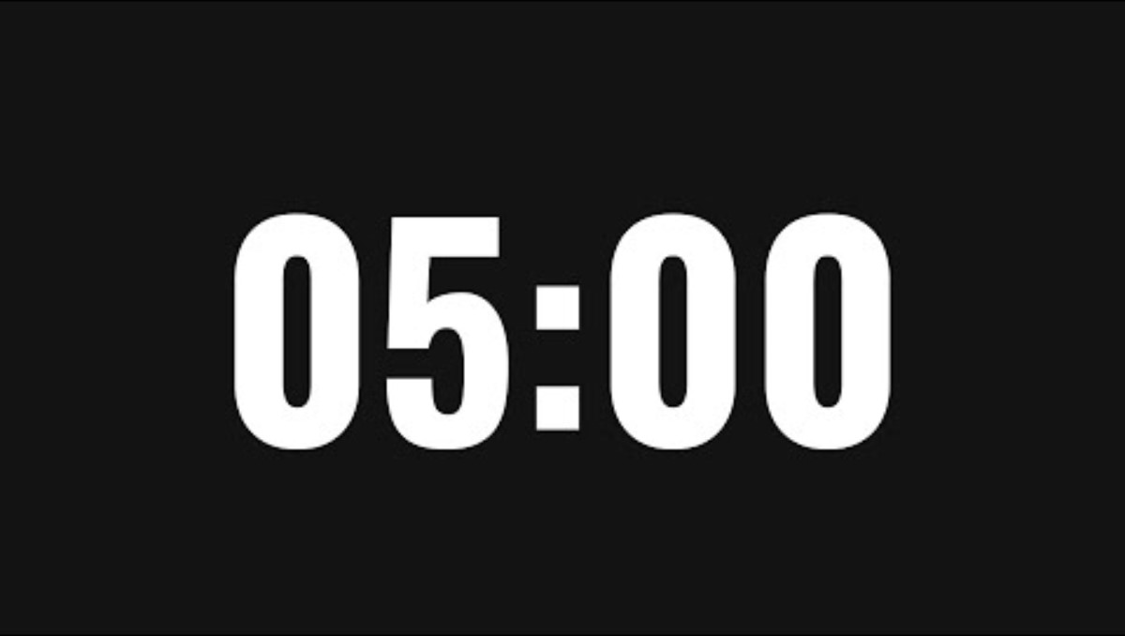
Challenge #1
picoCTF challenge "information"

Slide 7
Disk Forensics
Analyzing storage media (hard drives, SSDs, USBs, disk images) to uncover hidden or deleted information.
Deleted files often remain recoverable until overwritten
Mostly involves mounting or extracting from .img or .iso files
Always check the obvious first. Open files like flag.txt, images and read the metadata.
Filenames, weird timestamps, or strange directory structures often point to the flag.
Many disk challenges hide flags in base64, hex, or compressed files.

Slide 8

If running on Mac download Homebrew first
Open terminal and run "brew install autopsy"
In terminal run autopsy
Open URL provided

Slide 9
Challenge #2
picoCTF challenge "Sleuthkit Apprentice"

Slide 10
Resources
hexed.it - Free browser based hex editor
base64decode.org - Free browser based base64 decoder
metadata2go.com/view-metadata – Free browser based metadata viewer
Autopsy.com - Digital forensics platform (Need homebrew on mac)

